Slide 1
A METHOD BASED ON DEEP LEARNING FOR IDENTIFYING INDIVIDUALS THROUGH THE USE OF EAR BIOMETRICS
GUIDE NAME
Ms. J. IRINE PRIYA
ASSISTANT PROFESSOR /MCA
BY
HARI PRASATH . M
II MCA
311421622016

Slide 2
ABSTRACT
In order to determine the elements of the human ear recognition is based on gender categorization using ear image analysis and ear symmetry analysis
We use model-based analysis and deep learning methods to improve both framework and performance
According to past studies, human ears can be used for identification, gender classification, and verification of family
We focus on other qualities, such as ridge patterns, the contour of the earlobe, the size of the ear, and the shape of the ear
Our results show that transfer learning with ResNet50 is an effective approach for gender classification on ear images
This approach has the potential to lead to new insights in the field and could have practical applications in biometric identification systems

Slide 3
OBJECTIVES
To collect a diverse and representative dataset of ear images for gender classification
To preprocess the ear images by resizing, cropping and normalizing them to ensure consistency
To use transfer learning with ResNet50 to train a gender classification model on the ear images, focusing on features such as the shape and size of the ear, earlobe shape, and ridge patterns
To evaluate the performance of the model on different subsets of the dataset to ensure its generalizability, and to fine-tune the hyperparameters and prevent overfitting
To test the performance of the model on a testing set to evaluate its generalizability and determine its accuracy in gender classification

Slide 4
COMPANY NAME
MAJESTIC TECHNOLOGIES providing Industrial, Academic projects, Research solutions and Internship Training
20 years of experience with perfect infrastructure, lab set up, work shop, Expertise faculties make us competitive service providers in the field
It can be converted to online leads, sales and profits. Our employment oriented training covers the entire gamut of skills needed to get the employment
MAJESTIC PROJECT is a professional engineering project services company dedicated to meet the exact and time-sensitive Mechanical and core branch engineering needs of students

Slide 5
SOFTWARE REQUIREMENTS
OPERATING SYSTEM: Windows 64 bit
LANGUAGE: Python
PLATFORM: Anaconda3
HARDWARE REQUIREMENTS
SYSTEM: Intel core I3 processor 64 bit
RAM:4.00GB
ROM:100 GB

Slide 6
INTRODUCTION
Ears have been recognized as a trustworthy biometric due to their uniqueness and are not affected by facial expressions
Various research approaches, including deep learning, have been used to study ear recognition on standardized datasets like XM2VTS and SC face
The individuality of a person's ear is a crucial factor in biometrics
The capacity of ear biometrics on unconstrained ear images needs to be understood for real-world applications, regardless of the ear's position relative to the camera
The bilateral symmetry of ears and the specific sections that should be emphasized for recognition are still unknown based on current research
Ears are often overlooked when it comes to privacy concerns and they are rarely recorded in identifying documents
Compared to fingerprints, the age of ears varies less slowly than that of faces and ear pictures can be acquired from a distance without the subject's permission

Slide 7
EXITING SYSTEM
In existing system we have shown that human ears may be utilized for identification, gender classification, and kinship verification
They have also looked into whether a person’s ears are symmetrical
However the symmetry performances have not been very good
We conduct an evaluation of a large number of different existing methods
In order to discover which algorithm performs better and gives higher levels of accuracy

Slide 8
DISADVANTAGES
Mistakenly identify someone's gender or identity
Posing risks of unauthorized access or misuse of biometric data
They focus on symmetry and overlook other important ear features
It may struggle to accurately identify individuals or classify their gender
Fail to maintain consistent accuracy in diverse populations or real-world scenarios

Slide 9
PROPOSED SYSTEM
Proposed system expands on gender classification on ear photographs and examines bilateral symmetry of human ears
Goal is to identify specific ear portions that serve as the basis for recognition in each case
Utilizes model-based analysis and deep learning techniques for improved structure and performance
Ear is modeled as a flat plane attached to the head, considering rotation of ear pictures under an affine transformation
Investigates the feasibility of identifying individuals through ear biometric classification

Slide 10
ADVANTAGES
It speed up the authentication process by analyzing ear pictures
More accurate gender classification
It can handle large volumes of information and complex patterns
It exploring the relationship between ear features and gender classification
It aims to minimize false positives and negatives by combining different attributes

Slide 11
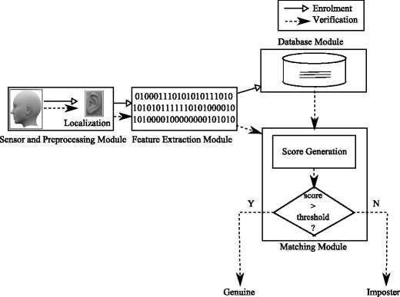
METHODOLOGY
SYSTEM ARCHITECTURE

Slide 12
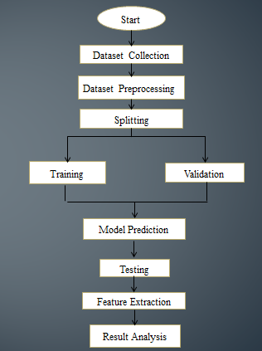
DATA FLOW DIAGRAM

Slide 13
SEQUENCE DIAGRAM:
DATASET
COLLECTION
MODEL
PREDICTION
EVALUTION
Training
Feature Extraction
Data Analysis
Image Preprocessing
Validation
Result Prediction
Split into Two Types
Model Generation

Slide 14
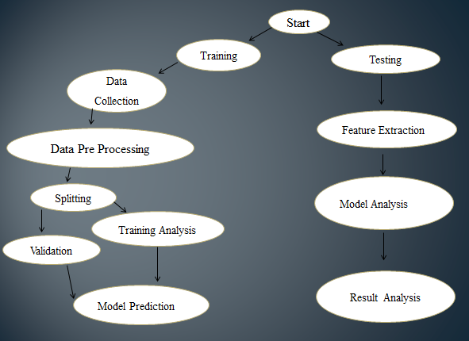
USE CASE DIAGRAM

Slide 15
IMPLEMENTATION
MODULE DESCRIPTION
Dataset Collection
Preprocessing
Dataset Splitting
Transfer Learning
Evaluation

Slide 16
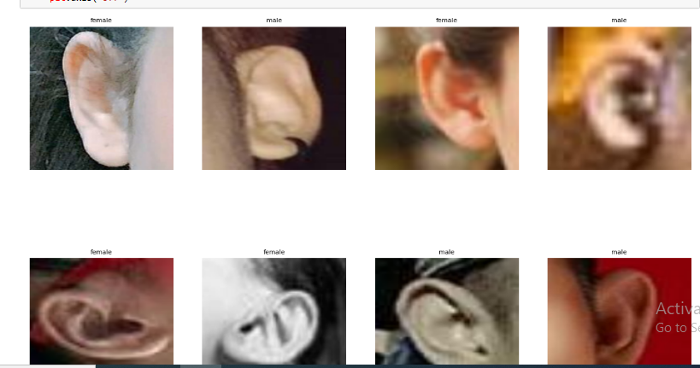
DATASET COLLECTION
This module involves collecting a diverse set of ear images that are representative of the population
The images should cover different ethnicities, ages, and genders, with varying lighting conditions and angles. The dataset be obtained from public sources

Slide 17
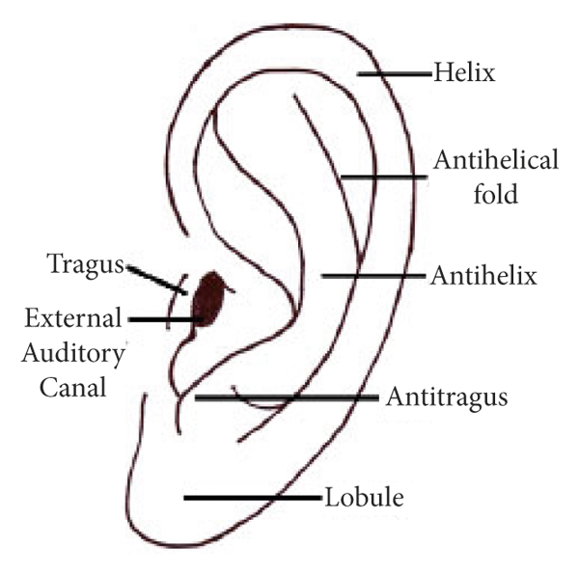
PREPROCESSING
This module involves preprocessing the ear images to ensure consistency and reduce noise
Techniques such as resizing, cropping and normalization may be applied to ensure that the images have a consistent size and brightness level
Additionally, the module involves feature extraction to extract meaningful features such as earlobe shape, ridge patterns, and ear shape

Slide 18
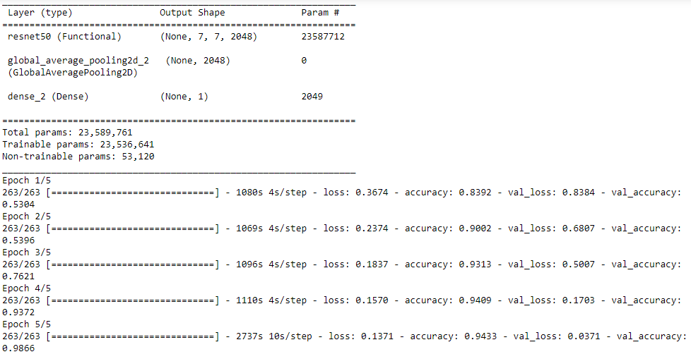
DATASET SPLITTING
This module involves splitting the dataset into training, validation, and testing sets
This is a standard practice in machine learning to evaluate the performance of the model on new data
TRAINING AND VALIDATION

Slide 19
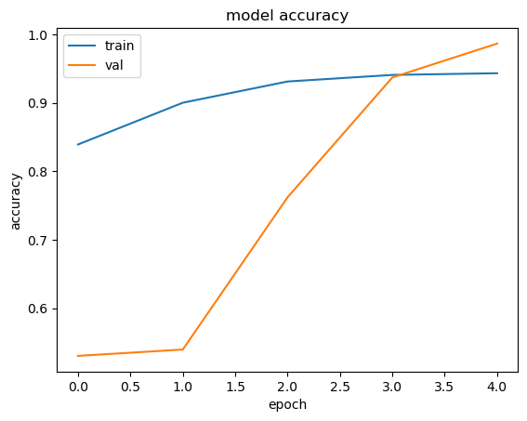
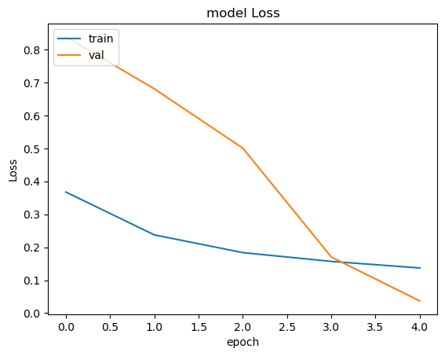
TRANSFER LEARNING
This module involves using transfer learning with the ResNet50 model to train a gender classification model on the ear images
Transfer learning allows the model to leverage pre-trained weights to improve its performance on a new task
MODEL ACCURACY
MODEL LOSS

Slide 20
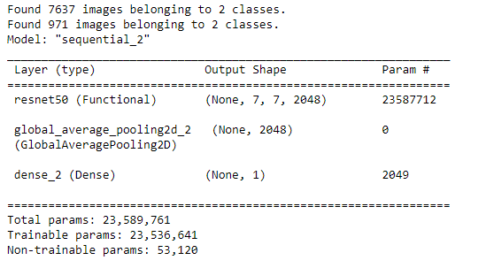
EVALUATION
This module involves testing the performance of the model on the testing set to evaluate its generalizability
Additionally, the module involve the use of visualization techniques to analyze the learned features and gain insights into the model's decision-making process
MODEL PREDICTION

Slide 21
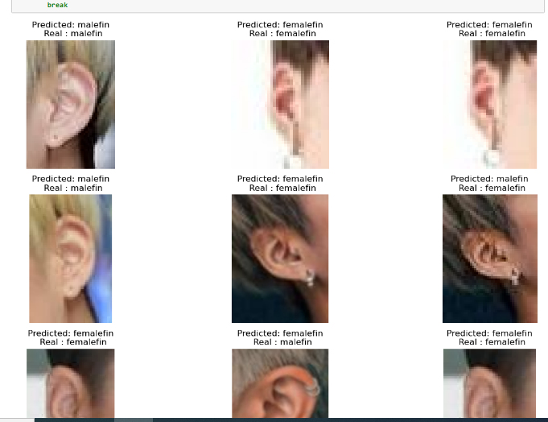
OUTPUT PREDICTION

Slide 22
EVALUATION METRICS
Accuracy: This metric measures the percentage of correctly classified gender labels for the ear images
Precision: This metric measures the proportion of true positives (correctly identified males/females) over the total number of positives (identified as males/females)
Recall: This metric measures the proportion of true positives over the total number of actual positives in the dataset
F1 Score: This metric is the harmonic mean of precision and recall, and is a good indicator of the overall performance of the model
Confusion Matrix: This is a table that shows the actual and predicted labels for the ear images, and can be used to calculate other evaluation metrics such as precision, recall, and accuracy

Slide 23

Accuracy = (Number of correct predictions) / (Total number of predictions)
Precision = true positives / ( true positives + false positives)
Recall = true positives / ( true positives + false negatives)
F1 score =2*(precision *recall)/(precision + recall)

Slide 24
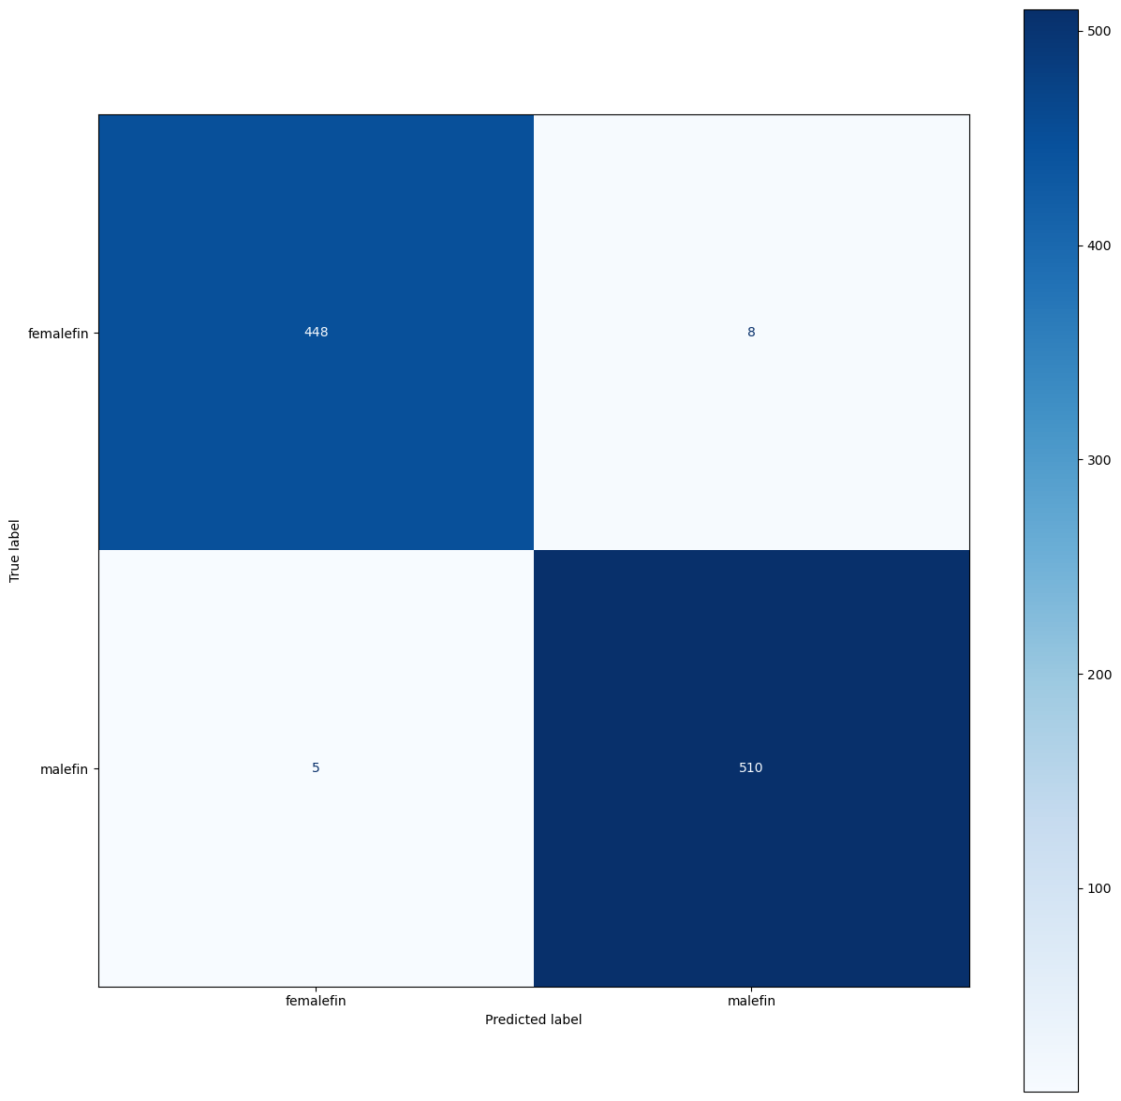
CONFUSION MATRIX

Slide 25
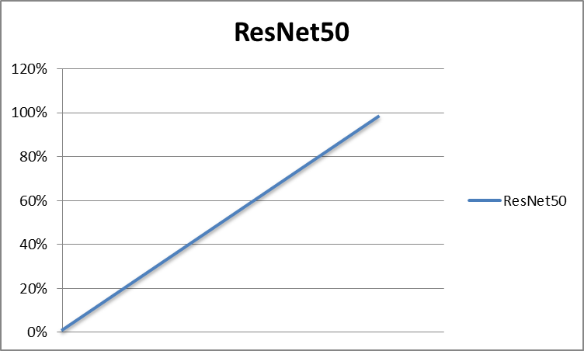
PERFORMANCE ANALYSIS
In this Proposed System, we use ResNet50 algorithm to classify the gender based on images
We achieve the highest accuracy of 98% which is more than our Existing System
This algorithm is used to speed up the authentication process, improve accuracy, handle large amount of data and predict the gender classification

Slide 26
COMPARING RESULTS WITH EXISTING SYSTEM
TITLE | ALGORITHM | ACCURACY
Ear biometrics using Deep Learning: Applied computational intelligence and soft computing | CNN | 92%
On Distinctiveness and Symmetry in Ear Biometrics | VGG-16 | 80%
Ear Recognition Based on Deep Unsupervised Active Learning | AlexNet | 94.5%
A method based on deep learning for identifying individuals through the use of ear biometrics | ResNet50 | 98%

Slide 27
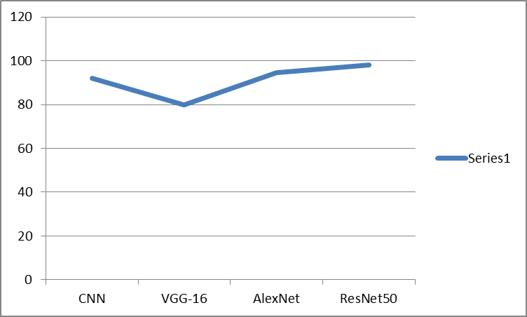

Slide 28
PSEUDO CODE
1.Input: Image of the ear to be authenticated
2. Preprocess the image (e.g., resize, normalize, cropping)
3. Extract ear features using a feature extraction method
ResNet_model = ResNet50(weights=’ImageNet’, Include_top=False,
Input_shape=(224, 224, 3))
4. Create a reference database of enrolled users' ear features
"user1": extract_ear_features("user1_ear.jpg")
5. Input: User's ear features from step 3
6. Compare the user's ear features with the ones in the reference database
7. Set a threshold for the similarity score to determine acceptance or rejection
threshold = 0.5
8. If the similarity score is above the threshold, authenticate the user as a match
for user, ref_features in reference_database.items():
names=["Female","Male"]
result=names[1]
if(predictions[0][0]<0.5):
result=names[0]
print("Predicted Result ", result)
plt.imshow(img)
9. If the similarity score is below the threshold, reject the user's authentication
10. End

Slide 29
CONCLUSION
The article discuss a model-based approach and a machine learning approach for ear recognition, focusing on bilateral symmetry and gender classification
It confirms the existence of bilateral symmetry in ear recognition, using deep learning for the first time
Crucial ear characteristics for recognition, gender classification, and bilateral symmetry are identified
Heatmaps in the article compare regions relevant to ear recognition and gender classification
The research findings reveal that jewelry does not affect the rate of ear recognition in bilateral symmetry analysis

Slide 30
FUTURE ENHANCEMENT
Increase confidence in a person's identification by combining data from a number of different biometric modalities, such as ear recognition, facial recognition, and fingerprint analysis
To achieve this goal, it may be necessary to create a multimodal fusion system that integrates data from multiple biometric modalities
Incorporate a method for ongoing learning so that the model can evolve and improve as it is exposed to fresh data
In practical contexts where populations are dynamic, such information can be invaluable
Investigate cutting-edge privacy-preserving methods like federated learning and secure multiparty computation to keep personal biometric information safe
To improve classification accuracy any more, you could look into more advanced transfer learning techniques and designs beyond ResNet50, such as larger or custom-designed neural networks

Slide 31
REFERENCES
Amir Benzaoui,et.al,2022,Deep learning using convolutional neural network is better than standard machine learning techniques for ear biometrics.
Iyyakutti Iyappan Ganapathi,et.al,2022, This article reviews existing 3D ear recognition techniques, focusing on three primary categories: registration-based recognition, local and global feature-based recognition.
B. Karthikeyan,Et.Al,2022, Multimodal biometric algorithm integrates Iris and Finger Print traits for robust and secure authentication.
Neeru Bala, Rashmi Gupta,et al,2022,Multimodal biometrics, which combine various human characteristics for authentication, can increase the recognition rate compared to uni
modal systems.
I. Ganapathi, S. S. Ali and S. Prakash, "Geometric statistics-based descriptor for 3D ear recognition", Visual Comput., vol. 36, no. 1, pp. 161-173, 2020.
D. Meng, S. Mahmoodi and M. S. Nixon, "Which ear regions contribute to identification and to gender classification?", Proc. 8th Int. Workshop Biometrics Forensics (IWBF), pp. 1-6, 2020.

Slide 32
D. Meng, M. S. Nixon and S. Mahmoodi, "Gender and kinship by model-based ear biometrics", Proc. Int. Conf. Biometrics Special Interest Group (BIOSIG), pp. 1-5, 2019.
Mohammed Hasan Mutur,Essam Hammodi Ahmed,2022- This research proposes a system of ear recognition using RF and HOG to accurately recognise people from photographs of their ears.
Qianqian Wang,Zhiqiang Tao, et al,2022- AMvC networks generate samples based on fused latent representations to promote consistent clustering

Slide 33
THANK YOU

